Slide 1
Build a low-powered Arm voice assistant with Google TensorFlow Lite
Karl Fezer
AI Evangelist, Arm
@karlfezer

Slide 2
Agenda
Industry Trends
How to do machine learning on Arm Cortex-M CPUs
How to use TensorFlow Lite for Microcontrollers
Hands-on workshop!

Slide 3
Trends

Slide 4


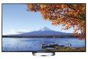
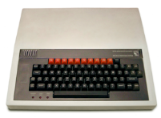
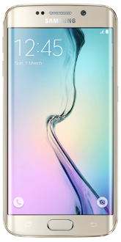
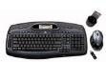

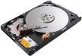
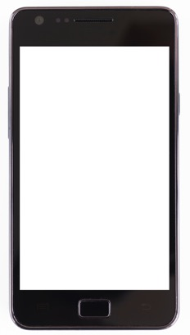

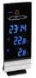
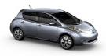
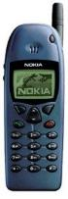
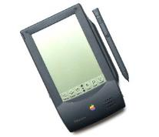
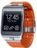


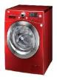

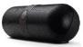

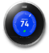
The next wave of computing
1990
1993 onwards
Today
Notes:
1- Joint venture between Acorn Computers and Apple
2- Designed into first mobile phones and then smartphones
3- Now all electronic devices can use intelligent Arm technology

Slide 5







Flexible, Scalable ML Solutions
Arm enables ML everywhere
Typical ML hardware choice
Data center
Autonomous driving
Image enhancement
Advanced
recognition
Arm NPUs
ML performance (ops/second)
Smart cameras
Pattern training
Mali GPUs
Keyword detection
Cortex-M/A CPUs
ML capabilities
Notes:
Today, over 95% of AI-enabled devices are in mobile, smart home and IoT market segments and under 5% in infrastructure. (Source: IDC Cognitive Study 2018)
From this we conclude, that over 90% of the AI-enabled units being shipped today are based on Arm architecture.
The software, processors, GPUs, ML accelerators and other hardware, that we offer as part of project Trillium -> supports a huge diversity of edge use cases like the ones you can see here.
Today we will focus on the low-cost low-powered always on, always aware, devices.
Deliver use cases with multiple hardware solutions
Choose best balance of ML performance versus capabilities per use case
NPUs are highest performance
Cortex-M MCUs lowest power and cost
“Nearly all mobile inference run on CPUs” Facebook paper: Machine Learning at Facebook: Understanding Inference at the Edge Facebook Research paper January 2019 https://research.fb.com/wp-content/uploads/2018/12/Machine-Learning-at-Facebook-Understanding-Inference-at-the-Edge.pdf and https://research.fb.com/publications/machine-learning-at-facebook-understanding-inference-at-the-edge/ and
https://www.zdnet.com/article/how-facebook-deals-with-the-fact-ai-is-a-mess-on-smartphones/
Main message: ML edge requires a mass-market, scalable platform for trillions of devices
You can run ML on existing Arm CPU and GPU platforms – you don’t need a dedicated accelerator
ML Accelerators enable new use cases which weren’t possible before (anything with a tick in the fourth column)
You want a smooth transition between these devices, and so need Arm NN
All these edge devices from cars to smartphones, and even servers as Drew said yesterday, are battery constrained. Here are some examples of applications mapped to the typical ML Hardware required. However, remember there isn’t one ML workload. What ML demands is to mix and match workloads across a scalable HW platform. Pick which hardware is best to use
Most use cases today run Arm CPUs or CPUS and GPUs only. You don’t always have, or need, an accelerator. And the cloud isn’t always accessible quickly. With the choice of hardware, it’s a question of tradeoffs.
ADD TECHNICAL BENEFITS OF WHY CPUs do ML well. Most ML applications start with the CPU….Many times a CPU is all you need
ADD TECHNICAL BENEFITS OF WHY GPUs do ML well …. Many times a CPU and GPU is all you need
Some will transition to needing dedicated ML hardware. Accelerators need to support many different markets, and will come in many different forms. We need to move workloads between devices. We need to move workloads to different accelerators.
Transition: Now that I’ve given some of the important technical requirements of CPUs and GPUs and some of the use cases where they perform best with ML, what’s important for dedicated ML hardware?
Notes description:
Pattern training: i.e. like a Nest thermostat that learns when want temperature that you typically like your home set at different times
Mali has a server design win with Tencent based on HiSilicon -- NDA

Slide 6

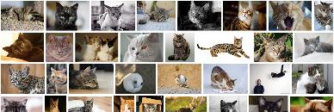
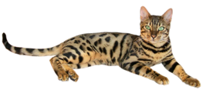

AI and ML Terminology
Training
Training data
Artificial Intelligence: Umbrella term for machines acting as though they are ‘thinking’
Neural network
Machine Learning: Machines adapting algorithms based on experience (e.g. labelled pictures)
Model
Trained to recognise cats
Deep Learning: Machine learning using Deep Neural Network approaches
Inference
New input
Neural network w/model
Algorithms: CNNs, RNNs, etc
A Cat
97.4% confidence
Not a Cat
Terminology
96.4% confidence
Notes:
… Terminology – in business these tend to be used loosely e.g. in China ML=AI.
[CLICK]
Training:
* Big Data - lots of data available via The Internet to use for training
* Extremely important to ensure this is unbiased; valuable and needs to be protected
[CLICK]
Inference:
* To be robust, it relies on good quality training
* Assumes a correlation between the new data and the data used for training
[CLICK]
* This is not an exact science – it’s all about probabilities
- very simple classification – CAT or NOT CAT
- more complex networks can provide multiple outputs

Slide 7



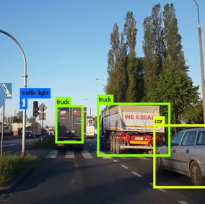
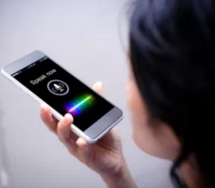
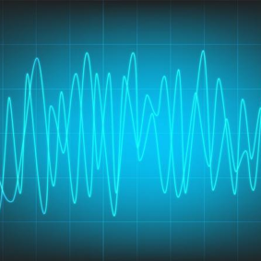
ML Edge Use Cases
Vision
Voice
Vibration
Images and video
Object detection, face unlock, defocus, beautification, etc.
Recognition and creation
Keyword spotting, speech recognition, natural language processing, speech synthesis, etc.
Any ‘signal’
Accelerometer, pressure, lidar/radar, speed, shock, vibration, pollution, density, viscosity, etc.
Notes:
ML performs well at ‘patterns’ of data
Preventive maintenance

Slide 8









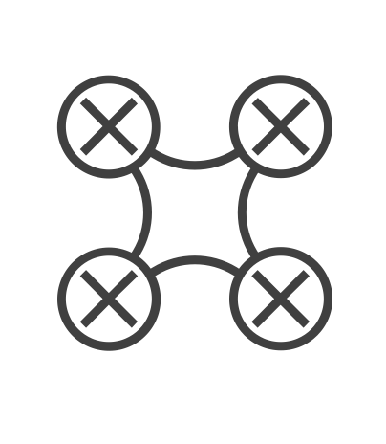

Drivers for running ML on endpoint devices
Security and Privacy | Power and Cost | Reliability
Notes:
Time-critical applications

Slide 9
Machine Learning on Cortex-M CPUs

Slide 10
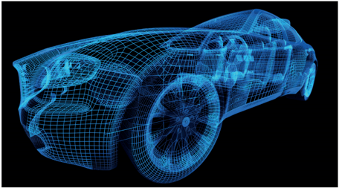


TinyML
Delivering on-device intelligence with “mW” of power
Intelligent anomalies detection
Body control unit application
Face/object detection for scene wake-up
Keyword spotting
Healthcare sensor module

Slide 11
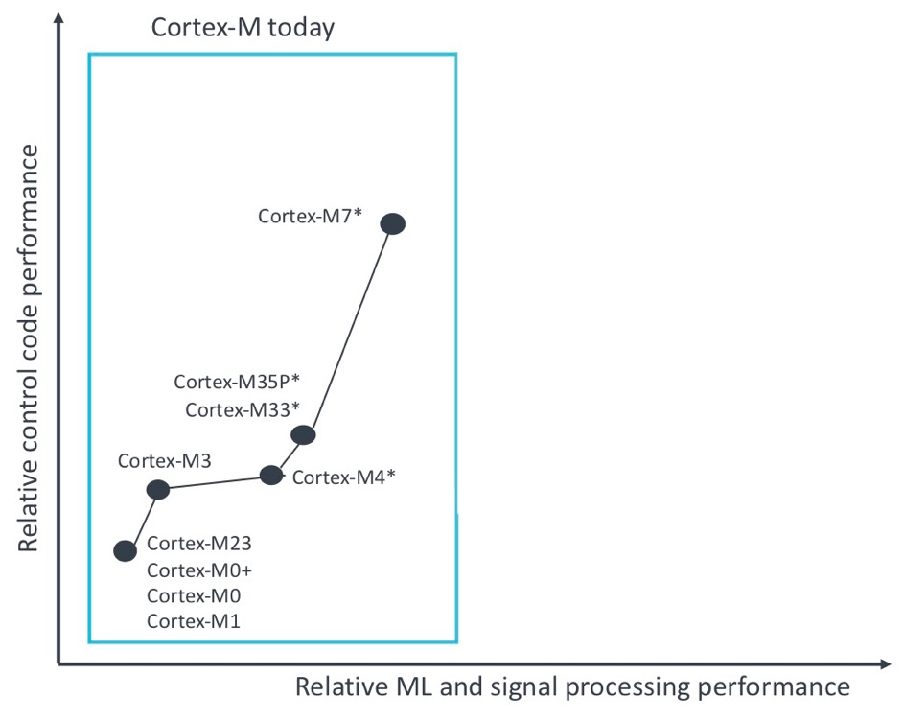
Arm Cortex-M processor
Optimized for cost and power-efficient microcontrollers
Future Cortex-M
enabled by Arm Helium technology
Enhanced ML capabilities with Cortex-M4 (Arm v7E-M), Cortex-M7 (Arm v7E-M), Cortex-M33 (Arm v8-M), Cortex-M35P (Arm v8-M), supports SIMD instructions
Arm Helium technology is a new M-profile vector extension(MVE) for Arm v8.1-M architecture.
Helium will deliver 15x more ML performance and 5x signal processing
* Processor with DSP extensions

Slide 12
Training a Keyword Spotting Model
Need compact models: that fit within the Cortex-M system memory
Need models with less operations: to achieve real time performance
Model: Depthwise separable convolution, fully-connected, softmax
Problem
Trained NN model
Deployable solution
Optimized code on HW

Slide 13
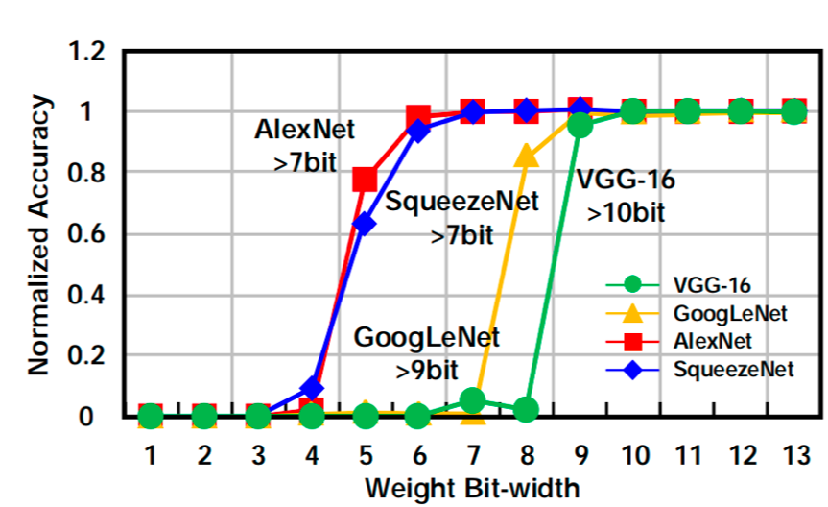
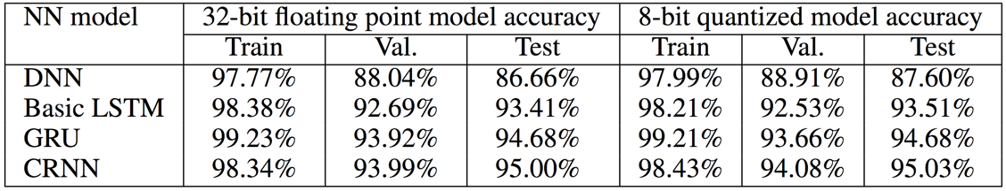
Quantizing NN Solutions for Cortex-M processors
1.2
Problem
1
AlexNet
>7bit
0.8
VGG-16
>10bit
SqueezeNet
>7bit
Normalized Accuracy
Trained NN model
0.6
VGG-16
GoogLeNet
AlexNet
SqueezeNet
0.4
0.2
GoogLeNet
>9bit
Deployable solution
0
1
2
3
4
5
6
7
8
9
10
11
12
13
Weight Bit-width
NN Model | 32-bit floating point model accuracy |  |  | 8-bit quantized model accuracy
 | Train | Val. | Test | Train | Val. | Test
DNN | 97.77% | 88.04% | 86.66% | 97.99% | 88.91% | 87.60%
Basic LSTM | 98.38% | 92.69% | 93.41% | 98.21% | 92.53% | 93.51%
GRU | 99.23% | 93.92% | 94.68% | 99.21% | 93.66% | 94.68%
CRNN | 98.34% | 93.99% | 95.00% | 98.43% | 94.08% | 95.03%
Optimized code on HW

Slide 14
Arm’s ML Computing Platform
@graphics to update this diagram
Voice, Vision & Vibration Applications
Inference Engine
ML Platform Direct Interface
Android NN API
Arm NN
CMSIS-NN
Hardware Abstraction Layer
OpenCL
OpenVX
Arm Compute Library
CMSIS-Core
Custom API
Arm Hardware for AI/ML
CPU
Arm Cortex-A, Cortex-M, Neon, DynamIQ
GPU
Arm Mali
ML processors
Partner IPs

Slide 15
Optimizing with CMSIS-NN
Problem
CMSIS – Cortex Microcontroller Software Interface Standard
CMSIS NN provides optimized low-level NN functions for Cortex-M CPUs
Functions implement popular NN layers: convolution, depthwise separable convolution, fully-connected, pooling, activation.
Trained NN model
Deployable solution
Table: Throughput and energy efficiency improvements by layer types
Layer type | Baseline runtime | New kernel runtime | Improvement
 |  |  | Throughput | Energy Efficiency
Convolution | 443.4 ms | 96.4 ms | 4.6X | 4.9X
Pooling | 11.83 ms | 2.2 ms | 5.4X | 5.2X
ReLU | 1.06 ms | 0.4 ms | 2.6X | 2.6X
Total | 456.4 ms | 99.1 ms | 4.6X | 4.9X
Optimized code on HW

Slide 16
OpenMV

Slide 17
TensorFlow Lite

Slide 18
TensorFlow Lite for Microcontrollers
TensorFlow is Google’s open source machine learning framework
TensorFlow Lite Micro is designed to run on embedded systems:
Less than 20KB binary footprint
No memory allocation
No library dependencies (not even POSIX or standard C/C++)
Code is at github.com/tensorflow/tensorflow/tree/master/tensorflow/lite/experimental/micro

Slide 19
TensorFlow Lite for Microcontrollers
One of the key use cases is audio
Started with speech wakeword detection
Example is on GitHub
You will have it working in a few minutes!
Still a work-in-progress, but we’re improving through collaborations
https://aiyprojects.withgoogle.com/open_speech_recording
100,000 utterances, but we need more

Slide 20
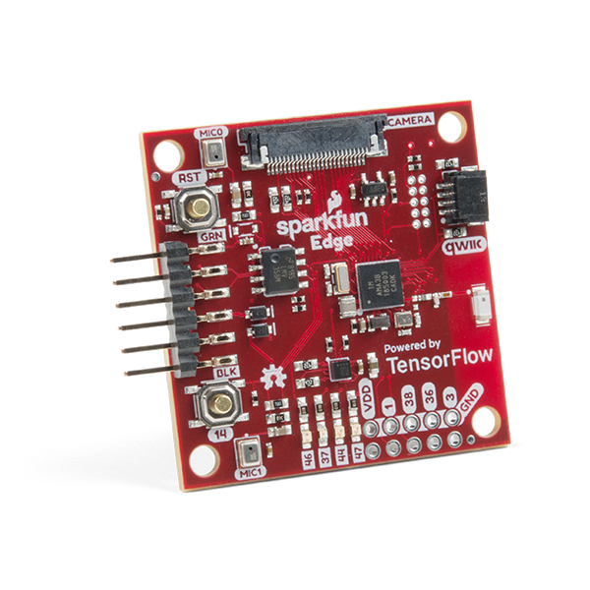
SparkFun Edge Development Board
32-bit ARM Cortex-M4F processor with Direct Memory Access
48MHz CPU clock, 96MHz with TurboSPOT™
Extremely low-power usage: 6uA/MHz
1MB Flash
384KB SRAM
Dedicated Bluetooth processor with BLE 5
https://www.sparkfun.com/products/15170

Slide 21
SparkFun Serial Basic Breakout - CH340C and USB-C
https://www.sparkfun.com/products/15096

Slide 22
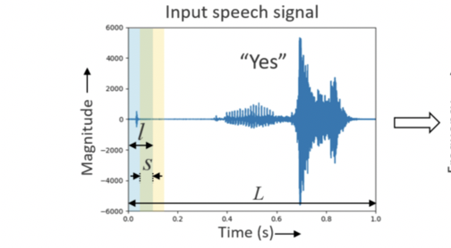
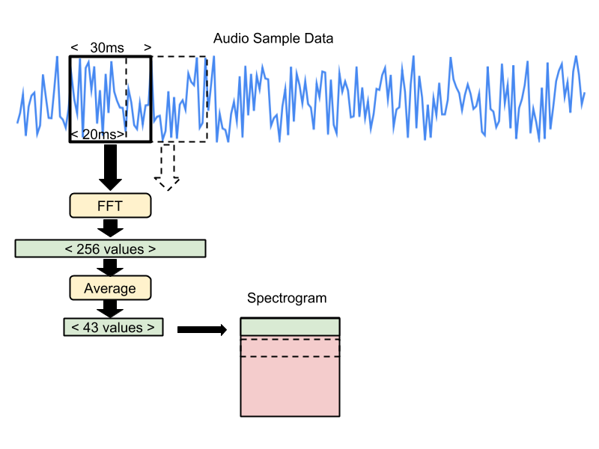
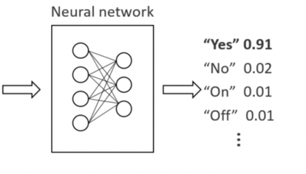
A Keyword Spotting Model
Notes:
Lets start with Hardware-Constrained neural network model search : for a “Keyword spotting” use-case.

Slide 23
Let’s get started!
codelabs.developers.google.com/codelabs/sparkfun-tensorflow/

Slide 24
How well did it do?
Why?

Slide 25
How well did it do?
Model accuracy decreases (slightly) due to the compression
Limitations of hardware
Noisy environment
Bias in dataset

Slide 26




















Summary
ML is moving to the IoT endpoint
Many ML use cases can be easily achieved with Arm Cortex-M CPUs
Ecosystem partnerships ensure ability to develop and deploy diverse use cases everywhere on the device
Energy grid
Automotive
Environmental
Home automation
Healthcare
Enterprise
Retail
Smart city
Wearables
IoT
Farming
Building automation
VR/AR
Space
Robotics
Sensor
Industrial
Identity & tracking
Smart lighting
Smart watch
Connected clothing
Notes:
I hope we’ve established, that it is important to drive increasing intelligence from the center of the network towards the edge.
We have seen lots of technical and commercial reasons for wanting to do that.
It’s going to happen, and it is happening now.
The improvements in ML models and the way we implement them are actually making this a reality.
The work we have done has proved that it can be done and there are now lots of other teams working on it, in Arm and in the rest of the ecosystem.
The Arm offering – software, processors, GPUs, ML accelerators and other hardware, part of project Trillium -> supports a huge diversity of edge use cases like the ones we discussed today.
Today we focused on the low-cost low-powered always on, always aware, devices.
And if there is only one thing that you take away from today it should probably be this:
If you take the time to choose a model with care the benefits of doing machine learning on resource constrained edge devices, is huge!

Slide 27
Next Steps!
Check out SparkFun – www.sparkfun.com
Check out TFLite –www.tensorflow.org/lite/microcontrollers/overview
Check out Arm Developer Pages – developer.arm.com/
Retrain the Model – developer.arm.com/armgooglevoice2019​ or
https://developer.arm.com/solutions/machine-learning-on-arm/developer-material/how-to-guides/build-arm-cortex-m-voice-assistant-with-google-tensorflow-lite/retrain-the-machine-learning-model

Slide 29
Backup

Slide 31
SparkFun Edge Development Board

Slide 32
Driver issues
Mac
https://stackoverflow.com/questions/55463159/sparkfun-edge-bootloader-problems
Linux, Mac, Windows
https://learn.sparkfun.com/tutorials/how-to-install-ch340-drivers

